Slide 1
A Performance Benchmark for Antidote
Guided By : Deepthi Akkoorath
Presented by : Kevin Bartik, Maxime Tchangou, Alka Scaria, Vishnu Vardhan Sundarrajan

Slide 2
Task Description
Develop a benchmarking solution for Antidote that allows to compare different versions of Antidote
Work – load generated should be suitable to compare the performance of different parts of Antidote
Generate a result file visualizing
Benchmarking tool should take as input a commit-id/branch name of the Antidote GitHub repository
A performance benchmarking for Antidote

Slide 3
STEPS
06.03.2018
A performance benchmarking for Antidote

Slide 4
Step 1 – Identifying Major Components
Output (Graph)
Antidote
Input
Benchmarking Tool
Input
Visualization
Docker
A performance benchmarking for Antidote

Slide 5

Step 2 – Decision Making
Programming Language
Operating System
IDE
Benchmarking Tool
Java
Windows
IntelliJ
Basho Bench
Erlang
Linux
Eclipse
YCSB
JMeter
A performance benchmarking for Antidote

Slide 6
Step 3 - Architecture
Antidote Container
Antidote Client
Antidote Client Wrapper
YCSB
YCSB Client
JFreeChart
Docker
Docker Manager
A performance benchmarking for Antidote

Slide 7
Outline
Docker Manager
Antidote Client Wrapper
Benchmarking using YCSB
Visualization of Results
A performance benchmarking for Antidote

Slide 8
Docker Manager (1/4)
Docker management was difficult using Docker-Compose and CLI
Goal: We wanted something that integrated well with the Java project
Solution: Docker Java API (Spotify Docker Client)
Benefits: Allows us to interact with Docker containers dynamically at runtime
A performance benchmarking for Antidote

Slide 9
Docker Manager (2/4)
We used a modified version of the Antidote Docker Image
Goal: Rebuild Antidote quickly for benchmarking different versions
Problem: Regular Image build takes several minutes
Solution: Rebuild Antidote in running container with original files
A performance benchmarking for Antidote

Slide 10
Docker Manager (3/4)
We used a modified version of the Antidote Docker Image
Benefits: Rebuilding Antidote inside the container takes only a few seconds
Problem: Antidote Dependencies may cause issues because our build is not clean!
Solution: Make sure that Antidote is in a valid state* and rebuild clean if necessary
*not fully implemented yet
A performance benchmarking for Antidote

Slide 11
Docker Manager (4/4)
Uses of the implementation
All basic interactions with containers (run, start, stop, remove)
Building our special Antidote Benchmark Image
Executing commands directly on the container (like rebuilding Antidote in the running container)
Ensuring that the Antidote database is in a valid state before running benchmarks
A performance benchmarking for Antidote

Slide 12
Benchmarking using YCSB (1/4)
What is YCSB?
YCSB – Yahoo! Cloud Serving Benchmark
YCSB is a framework for bench-marking systems.
Goal – develop framework.
Common set of workloads to benchmark the system.
Throughtput and Latency of the database operation.
A performance benchmarking for Antidote

Slide 13
Benchmarking using YCSB (2/4)
How to add a new database?
Create the DB interface layer.
Interface should be implemented with the operations.
Workloads
Helps to benchmark the DB.
Types of workloads
1. Core workload – 6 core workloads are available.
2. Custom workload – workload can be customized.
A performance benchmarking for Antidote

Slide 14
Benchmarking using YCSB (3/4)
How to create custom workload?
Workload file
New java class
Core properties helps to build the custom workload. Few sample properties are
Maxexecutiontime
readproportion
exportfile
A performance benchmarking for Antidote

Slide 15
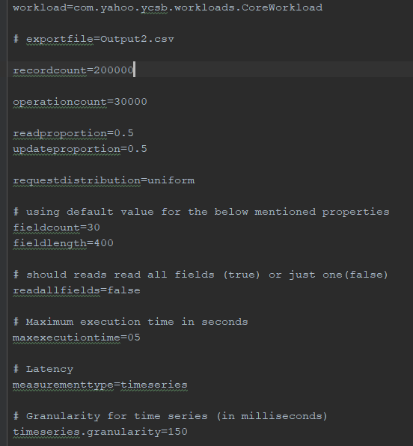
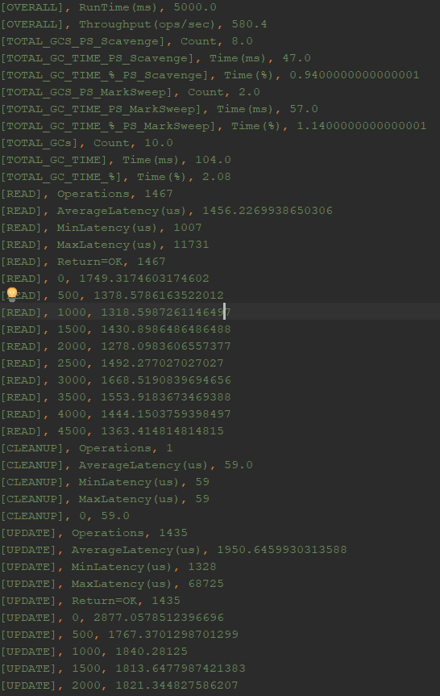
Benchmarking using YCSB (4/4)
A performance benchmarking for Antidote

Slide 16
Antidote Client Wrapper (1/2)
Interface between Antidote Database and any Benchmarking Tool
In the Antidote Client Wrapper
Start the Container
Get the HostPort
Start the Antidote Client
Read and Write Operations
A performance benchmarking for Antidote

Slide 17
Antidote Client Wrapper (2/2)
Antidote Client Wrapper
Operations
Single Read
Single Write
List of Read
List of Write
Combination of Read & Write
Read – Read List
Write – Update List
Fetches
YCSB Client
Public Status update(String table, String key, HashMap<String, ByteIterator> values)
{ ……..
}
YCSB DB
public abstract Status delete (String table, String key);
public abstract Status update (String table, String key, HashMap<String,ByteIterator> values);
A performance benchmarking for Antidote

Slide 18
Visualization of Results (1/6)
JFreeChart for the Visualization of Results
What is JFreeChart?
What kind of graphs can be modeled with JFreeChart?
What kind of Output-files can JFreeChart support?
A performance benchmarking for Antidote

Slide 19
Visualization of Results (2/6)
What is JFreeChart?
JFreeChart as a free 100% Java chart library
A performance benchmarking for Antidote

Slide 20
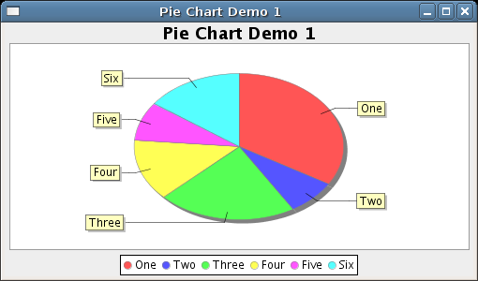
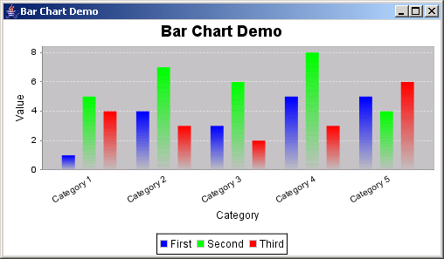
Visualization of Results (3/6)
What kind of graphs can be modeled with JFreeChart?
Pie Chart
Bar Chart
A performance benchmarking for Antidote

Slide 21
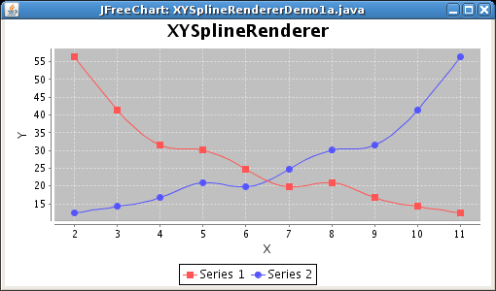
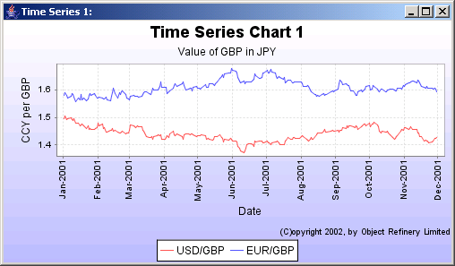
Visualization of Results (4/6)
What kind of graphs can be modeled with JFreeChart?
XY Chart
Time Series Chart
A performance benchmarking for Antidote

Slide 22
Visualization of Results (5/6)
What kind of Output-files can JFreeChart support?
Swing and JavaFX
PNG and JPEG
PDF, EPS and SVG
A performance benchmarking for Antidote

Slide 23
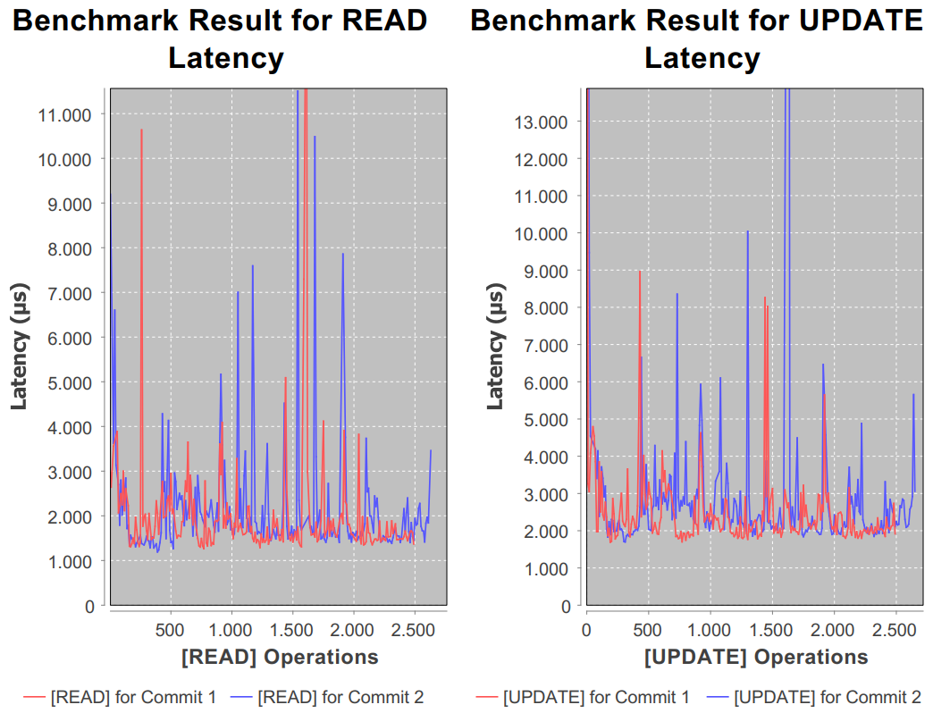
Visualization of Results (6/6)
Example:
A performance benchmarking for Antidote

Slide 24
Git Manager
Management of commits that are benchmarked
JGit (Java API for Git)
To access all commits the repository must be cloned locally
Check validity of commits before benchmarking
Reuse existing local repository of Antidote (only in clean state)
A performance benchmarking for Antidote

Slide 25
Settings Manager
Management of persistent application settings
MapDB (Simple Java database that is easy to use)
Save user selected benchmark commits and file locations
Possibility to store all keys of Antidote
A performance benchmarking for Antidote

Slide 26


